Slide 1

Creating Semantic Spaces Using Document Clustering
By: Tristan Weger, Ryan Rubadue, Yahya Emara

Slide 2

Project Goals
Goals:
Create a representation of natural language that captures meaning (semantic space) using long documents.
Compare different embedding methods (sentence, segment).
Display the semantic space of large dimensionality with a simplified 2 dimensional map.
Create a cognitive map that is easy to interpret and understand.

Slide 3
Intellectual Merits
Comparison of segment and sentence tokenization methods
Advantages and disadvantages of these methods are determined
Large documents are composed of many topics
the optimal number of clusters is calculated using the silhouette method metric
Information extraction from large documents contains lots of noise
This noise is properly parsed and filtered to get the most accurate results
This system uses a combination of machine learning and NLP methods including umap, nltk, and MPNET

Slide 4
Broader Impacts
There are many practical applications for this system.
Brainstorming - thinking of new ideas is challenging and time consuming, this system can take in ideas and output new similar ideas, preserving the problem solving process and saving time.
Text or article summarization - this system creates component embeddings and clusters that can be applied to a summarization system to create comprehensible shortened summaries of large documents or bodies of text
Language generation - this system creates a semantic space which is a representation of human language that creates meaning. This meaning can be applied to create a system that can generate accurate and coherent language.

Slide 5
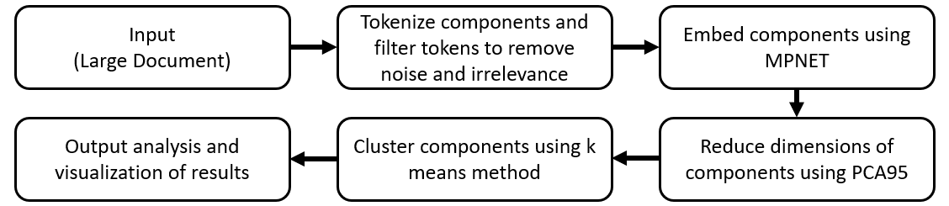
Design Specifications
A dataset of information must first be selected and input into the system.
Basic text filtering including short sentence removal is performed.
Sentences are tokenized and embedded into vectors of 768 dimensions using MPNET.
Further filtering is done to remove irrelevant sentences.
PCA 95 reduces the component dimensions to ~220.
K means clustering is performed and mapped onto a 2D plot using UMAP.
Word clouds are produced from clusters.

Slide 6
Technologies
Technologies Developed can be split into:
Text Filtering and Parsing Algorithms
Implementing NLTK techniques for Sentence Tokenization
Embedding and Segmentation Algorithms
Using the sentence transformers library and the MPnet-base-v1 model to embed the sentences into 768 dimensions
Separating the sentences into segments of related sentences using a segmentation algorithm that develops an accumulated score matrix and backtracking to determine the optimal segment splits while traversing the matrix
Dimensionality Reduction Algorithms
PCA-95 and PCA-90 algorithms to reduce dimensionality from 768 to 200-220 dimensions
Clustering Algorithms
Developed a K-means clustering function to cluster sentences onto a 2D semantic space
To generate a visual outcome, we used Umap algorithm to reduce dimensionality to 2D
Additionally, developed a word-cloud generating function to produce the most important words from each cluster, differing in size depending on how important a word is

Slide 7
Milestones
Broadview of deliverables for the project:
Finding a dataset that fits requirements of long documents that discuss various topics
Parsing and filtering the documents into clean sentences
Finding a suitable embedding algorithm and implementing it
Implementing a segmentation algorithm for the embeddings and testing for accuracy
Producing cosine-similarity matrices and heatmaps to compare segments
Normalization or standardization of results to improve performance
Filtering irrelevant sentences to improve performance
Implementing PCA-95 to reduce dimensionality
Using K-means clustering to obtain meaningful clusters from the data
Implementing Umap algorithm to produce a 2D visual outcome
Producing meaningful word-clouds for each cluster

Slide 8
Results
Currently:
Implementation of semantic analysis process when analyzing the text corpus at sentence level
Visualizations/metrics for each portion of semantic analysis process
Base level word clouds visualizations
By Expo:
Comparison between relative performance of process at each level
Improved clustering/visualizations
Analysis/optimization of sentence filtering methodologies

Slide 9
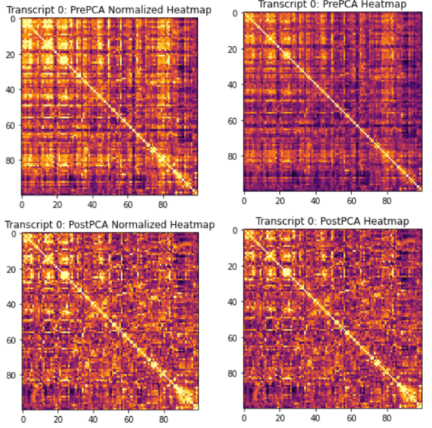
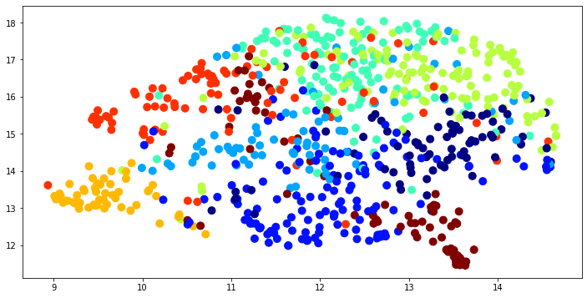
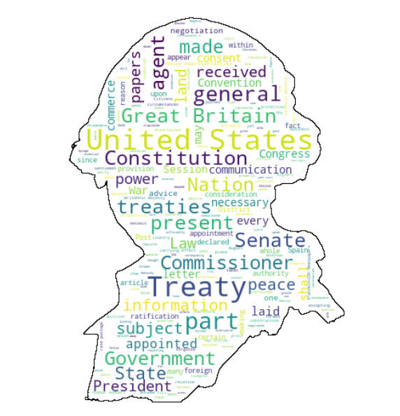
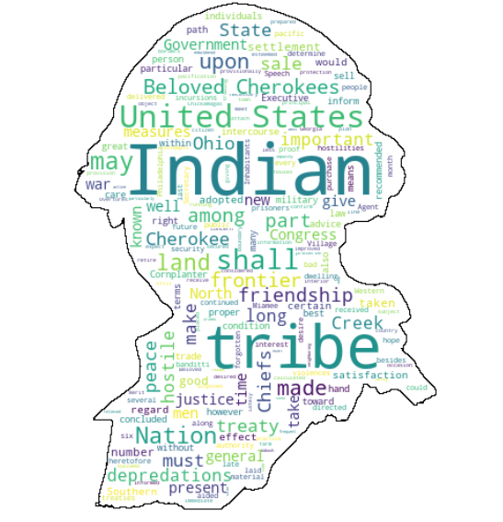
Sentence clusters of George Washington’s Speeches (8 Clusters)
Heatmaps for George Washington’s Speeches
Examples of Word Clouds Created for George Washington

Slide 10
Challenges
Managing extremely long application runtime
Google Colab used for executing application as a result
Review of application bottlenecks/potential time optimizations
Working with longer documents necessary for project goals
Exposure to several natural language processing concepts
Dimension reduction methodologies, advanced clustering methods beyond k means
Determining ‘useless’ tokens within document
Simple at word level, at sentence level much more difficult due to ambiguity

